Slide 1
Maine Offshore Wind Port Alternatives Review
By: Matt Burns, Maine Port Authority

Slide 2
OSW Ports – Quick Review
OSW requires very specific criteria not common in ports worldwide.
Fixed vs. floating port requirements are similar but starting to diverge.
There are currently no purpose-built floating OSW port facilities in the world.
A primary hub location is necessary to support a commercial OSW project.
Multiple ports may be developed to support the industry as it matures.

Slide 3
What are the most important characteristics of an OSW port facility?
Deep Water Access – 35 feet
No Overhead Restriction – Air Draft
Cargo Staging Area – High acreage, flat area
Heavy Loading Capacity – 5000-6000 psf
Dedicated Wharf Frontage – 1500ft +/-

Slide 4
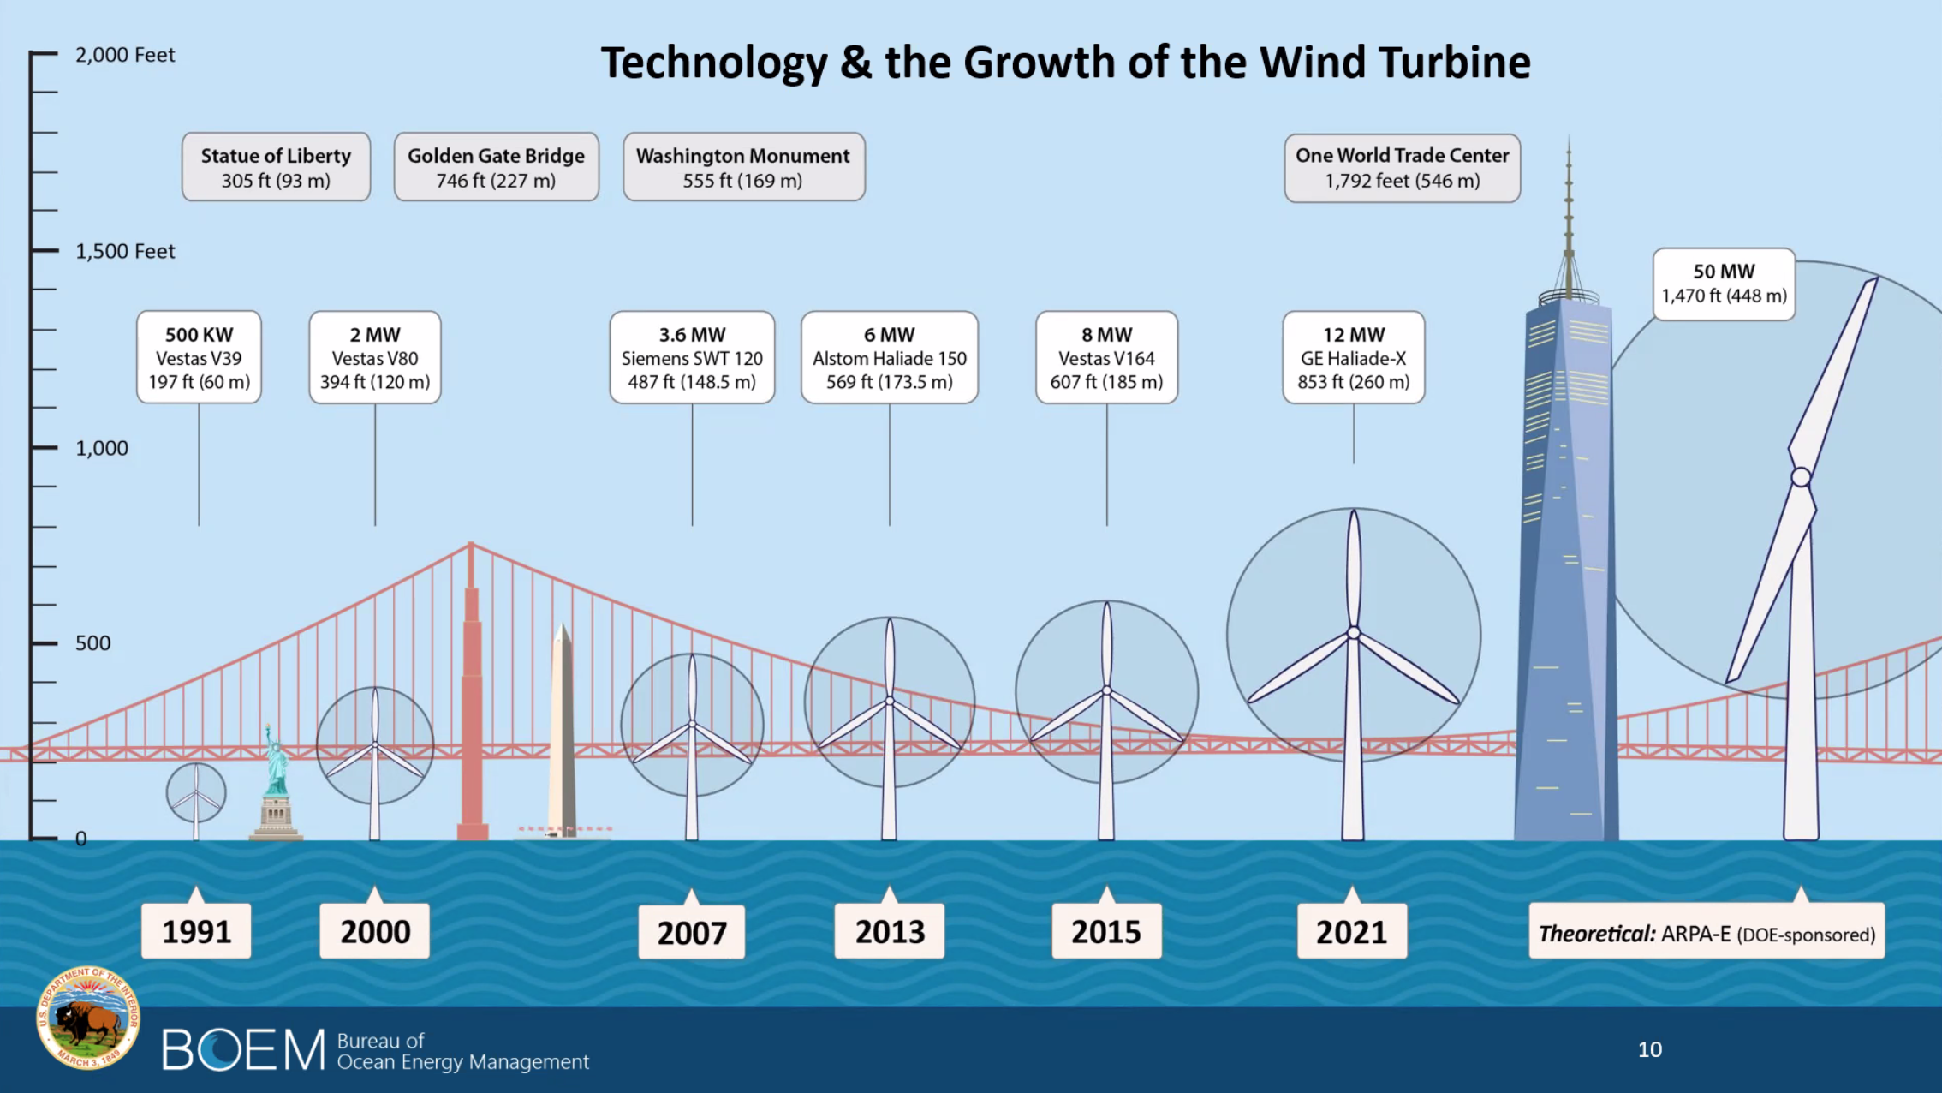

Slide 5
Where we started…
Sprague Put Parcel – 29 acres
GAC Chemical Industrial Park – 120 acres
Mack Pt. – 65 acres (commercial scale)
Sears Island – 65 acres (commercial scale)

Slide 6
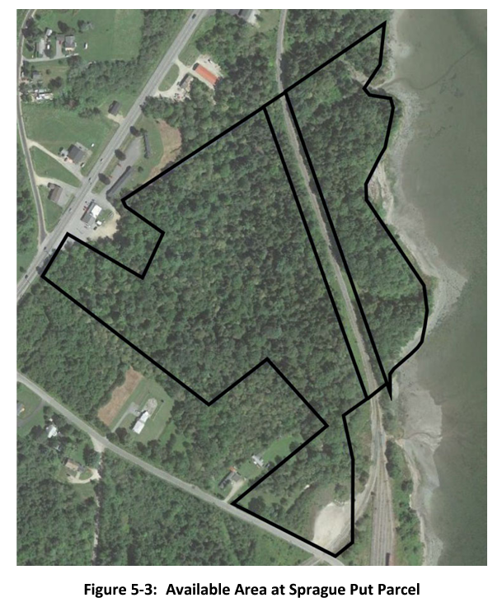
Sprague Put Parcel
29 acres of undeveloped land directly North of Mack Pt. terminal
1200lf of water frontage
No vessel access via nav channel
Significant dredging required to access site. 2 million cubic yards with an estimated cost of over $100 million for dredging alone.
Would require constant maintenance.
Interference from existing rail spur.
Low acreage.

Slide 7
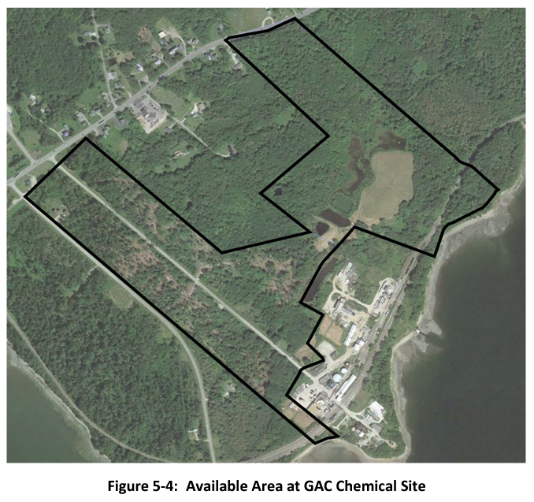
GAC Chemical Industrial Park
Two separate areas with a total of 120 acres.
Due to required water frontage, only the northern area was selected which is 55 acres with 840lf of water frontage.
No vessel access via nav channel.
5.5 acre covered landfill with unknown materials and level of compaction. Poor geotechnical characteristics and an upward cost driver due to landfill removal and replacement.
Significant dredge quantities. Would also require constant maintenance dredging.

Slide 8
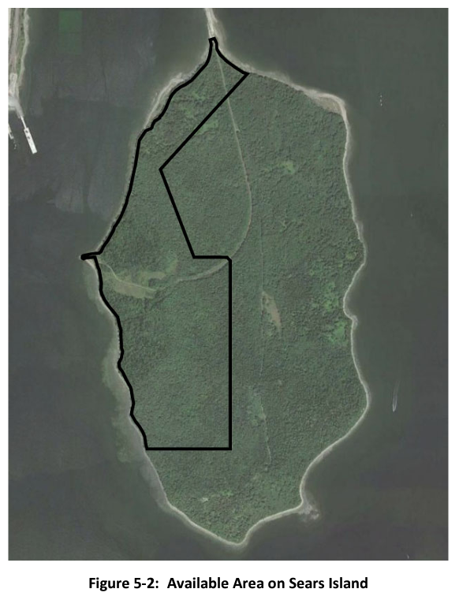
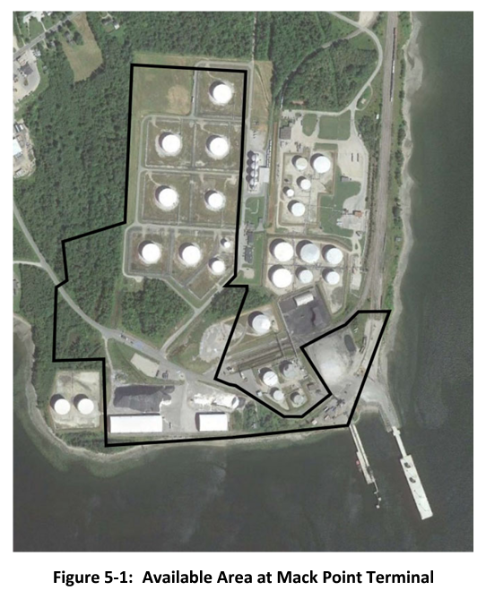

Slide 9
What has changed since 2020
Maine has made significant progress on the Roadmap effort.
BOEM has announced the first step in GoM commercial leasing.
Offshore wind developers are scaling up.
OSW technology continues to change.
We are designing concepts based on larger turbines. 20MW

Slide 10
OSW Marshalling Terminal Alternatives
Mack Point – 100 acres
Sears Island – 100 acres
Mack Pt/Sears Island Hybrid – 110 total acres
Eastport, Estes Head – 100 acres
No Build

Slide 11
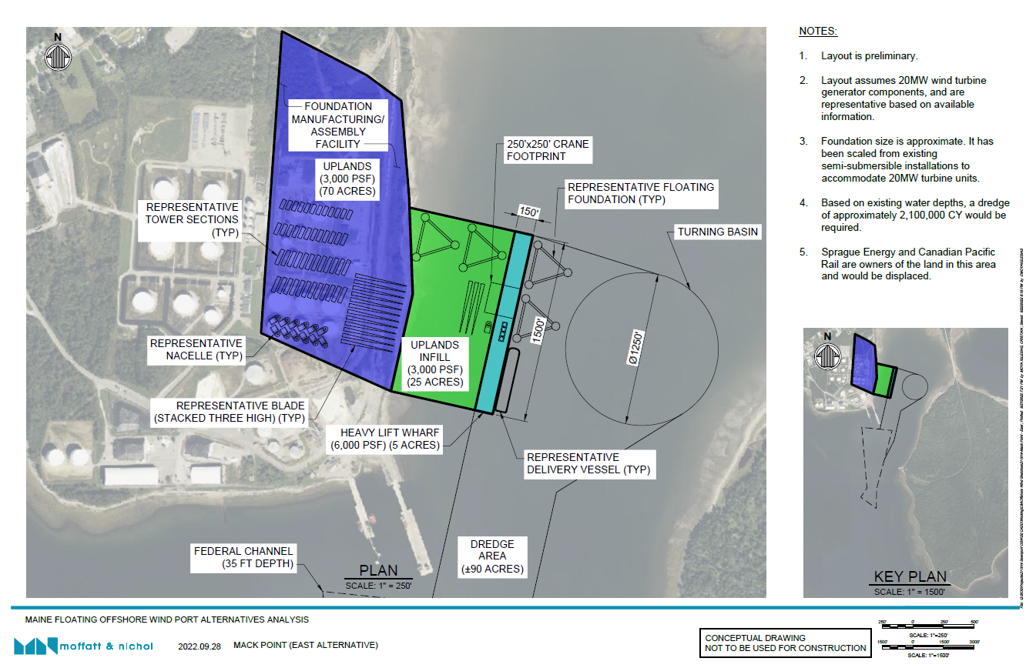

Slide 12
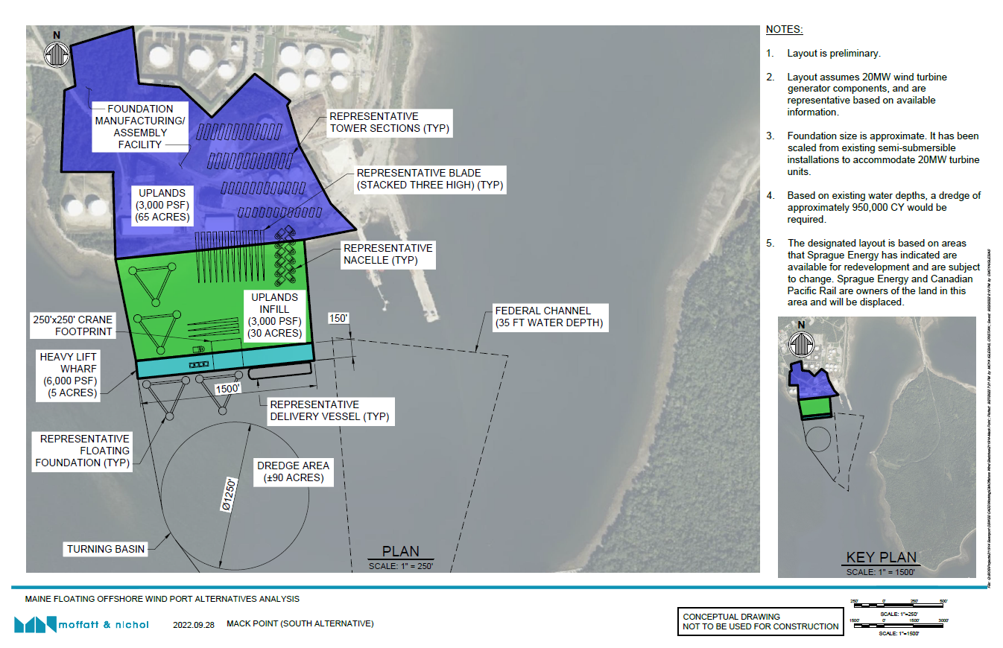

Slide 13
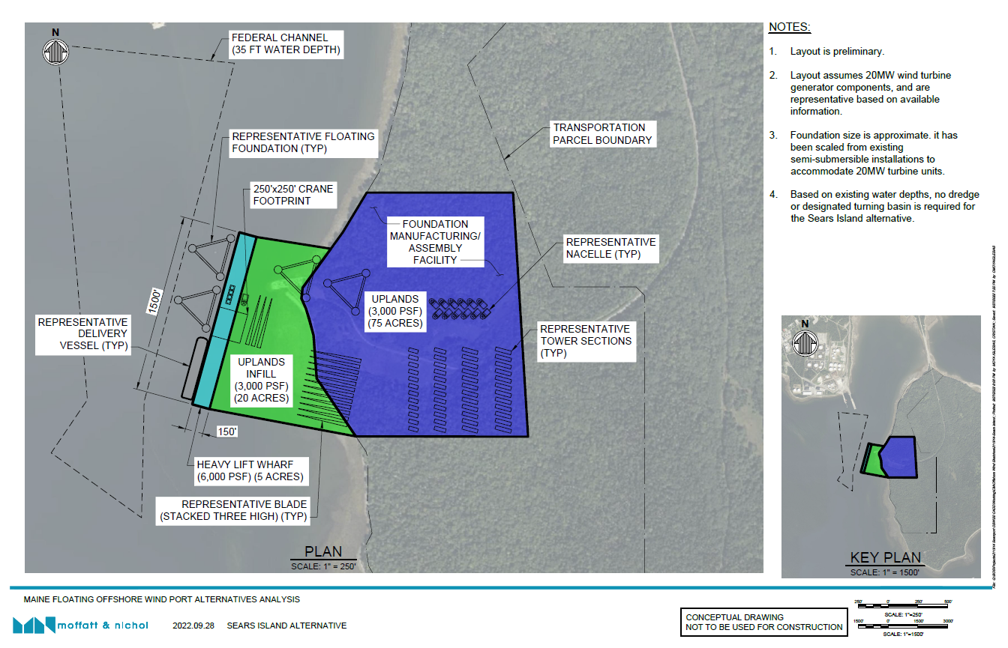

Slide 14
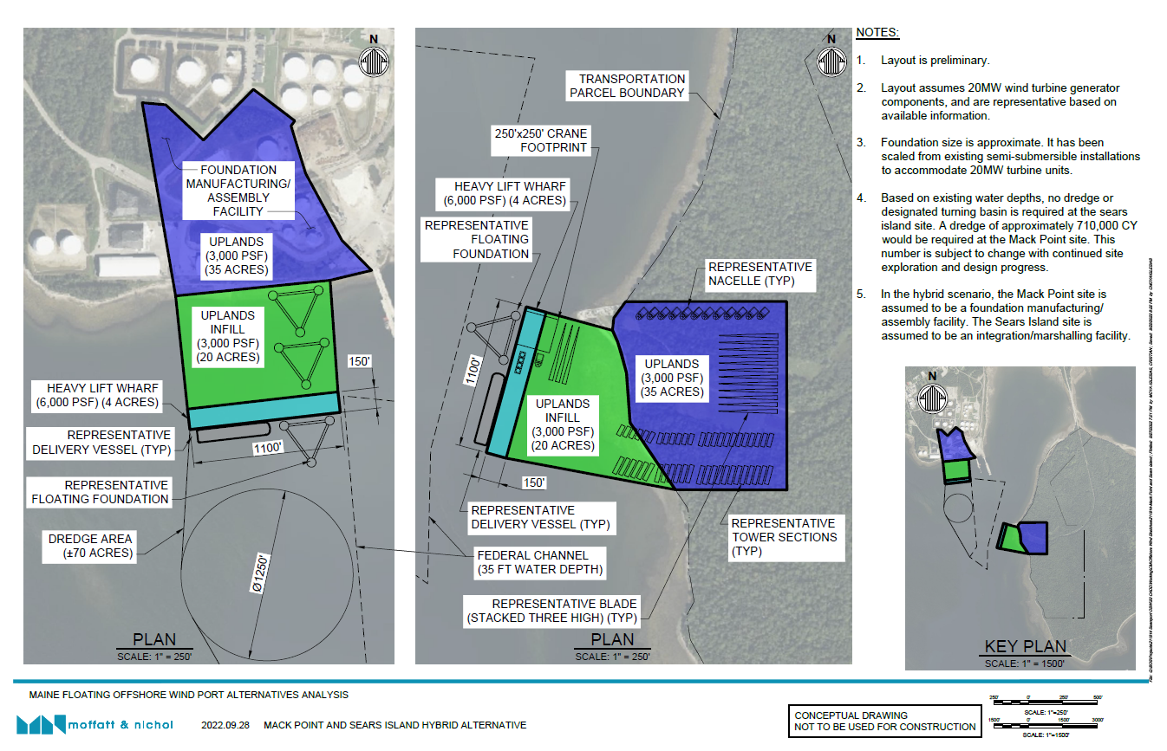

Slide 15
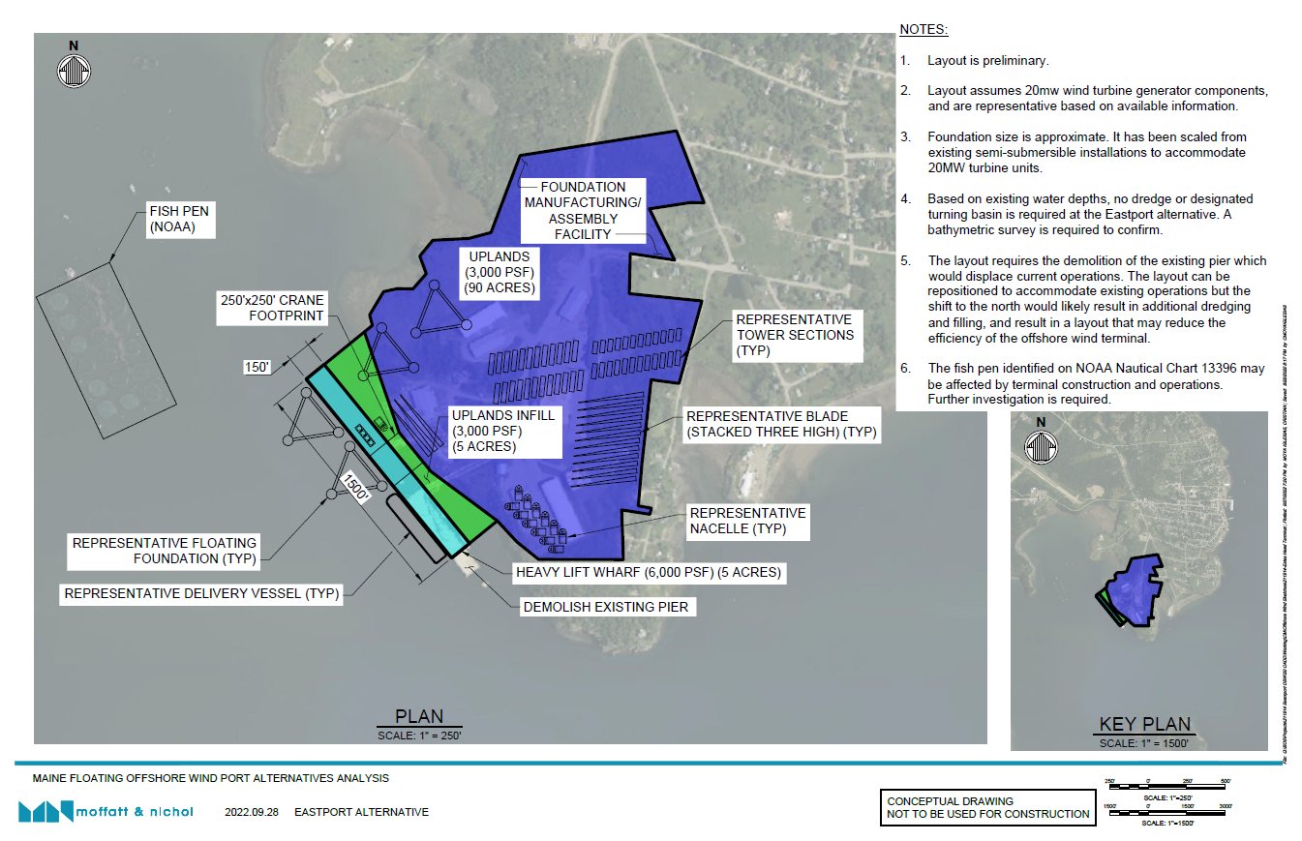

Slide 16
Closing Points to Make
The alternatives matrix will guide the OSWPAG in gathering necessary data for the analysis. Now that alternative concepts are identified, MaineDOT will work on filling out the matrix to compare sites.
Ability to expand the facilities is important to consider as co-locating port facilities is desirable.
No final decision has been made. There is a significant amount of work ahead for MaineDOT to continue gathering data, and for the OSWPAG to analyze, discuss and provide feedback.
Feedback from this meeting today will help us with adjusting these alternatives to continue refining concepts. This meeting is the beginning of the process.
Development will occur in phases, but the concepts are presented as being compatible with commercial scale OSW development. The first project in the Maine pipeline would be the Maine Research Array (12 turbines).
The demand for commercial development is still unknown but will become clearer as Maine develops procurement targets and the BOEM leasing process moves forward.

